Slide 1

Introduction to PHAZE
PHAZE is a proof-of-concept framework for low latency inference using ML-based triggers at the Large Hadron Collider, focusing on:
Early-exit ML models for fast decision making
Cryptographic primitives for secure data handling
Zero-knowledge machine learning (ZKML) integration
Modular architecture for easy component switching
Key Components:
Early-exit models (M_early): Lightweight ML models for quick inference
Cryptographic primitives: Hashing and polynomial interpolation
ZKML integration: Modular interface for different ZKML systems
Rust-Python bindings: Performance-critical components in Rust
Benchmarking suite: Performance testing across components

Slide 2
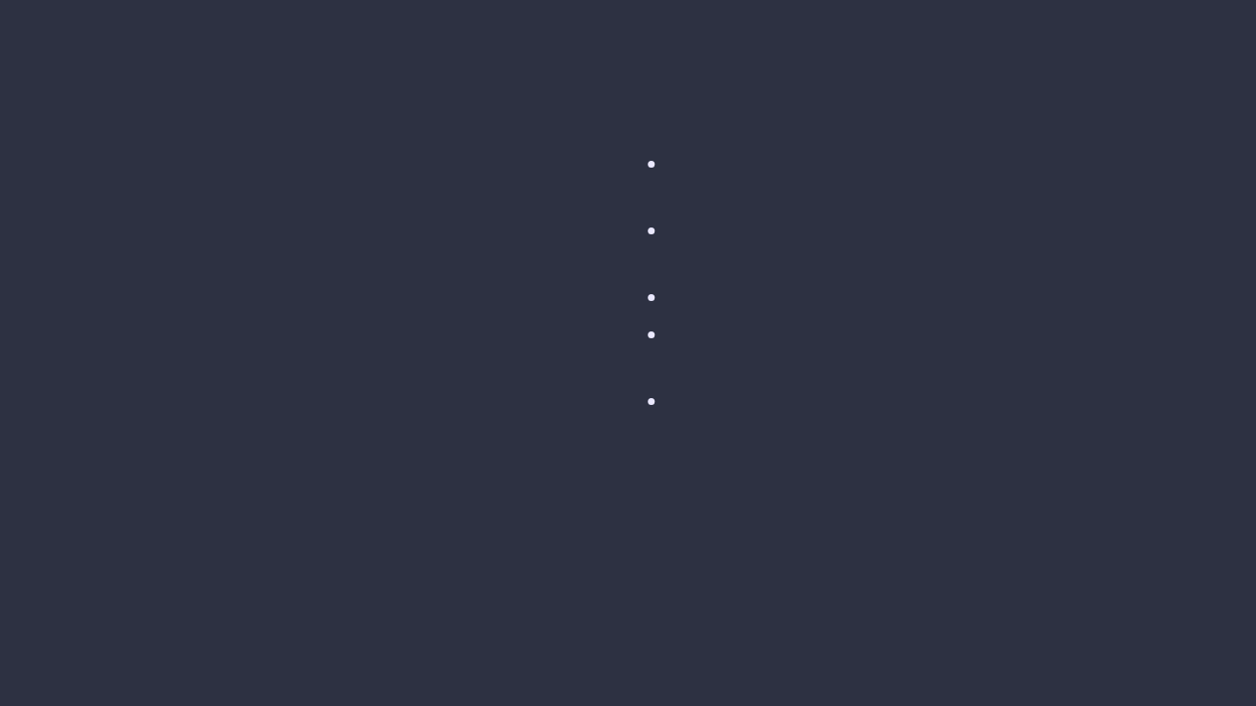
Project Structure
Core Components:
Key Modules:
early_exit_models.py
/phaze/
├── pyproject.toml # Project config
├── src/phaze/
│ ├── early_exit_models.py
│ ├── crypto_primitives.py
│ ├── zkml_integration.py
│ ├── rust_zkml_backend.py
│ └── benchmarking.py
├── rust_zkml_bindings/
└── tests/
: Toy early-exit ML models for fast inference
crypto_primitives.py
: Cryptographic functions (SHA256, polynomial interpolation)
zkml_integration.py
: Modular interface for ZKML systems
rust_zkml_backend.py
: Python wrapper for Rust functionality
benchmarking.py
: Performance testing suite

Slide 3

Installation Steps
1. Clone the repository:
git clone https://github.com/your_username/phaze.git
cd phaze
2. Install Python dependencies:
pip install -e .
3. Install Rust and Cargo:
curl --proto '=https' --tlsv1.2 -sSf https://sh.rustup.rs -o rustup-init.sh
chmod +x rustup-init.sh
./rustup-init.sh -y --no-modify-path
source $HOME/.cargo/env
4. Build Rust-Python bindings:
cd rust_zkml_bindings
pip install maturin
maturin build --release
pip install ./target/wheels/rust_zkml_bindings-*.whl
cd ..

Slide 4
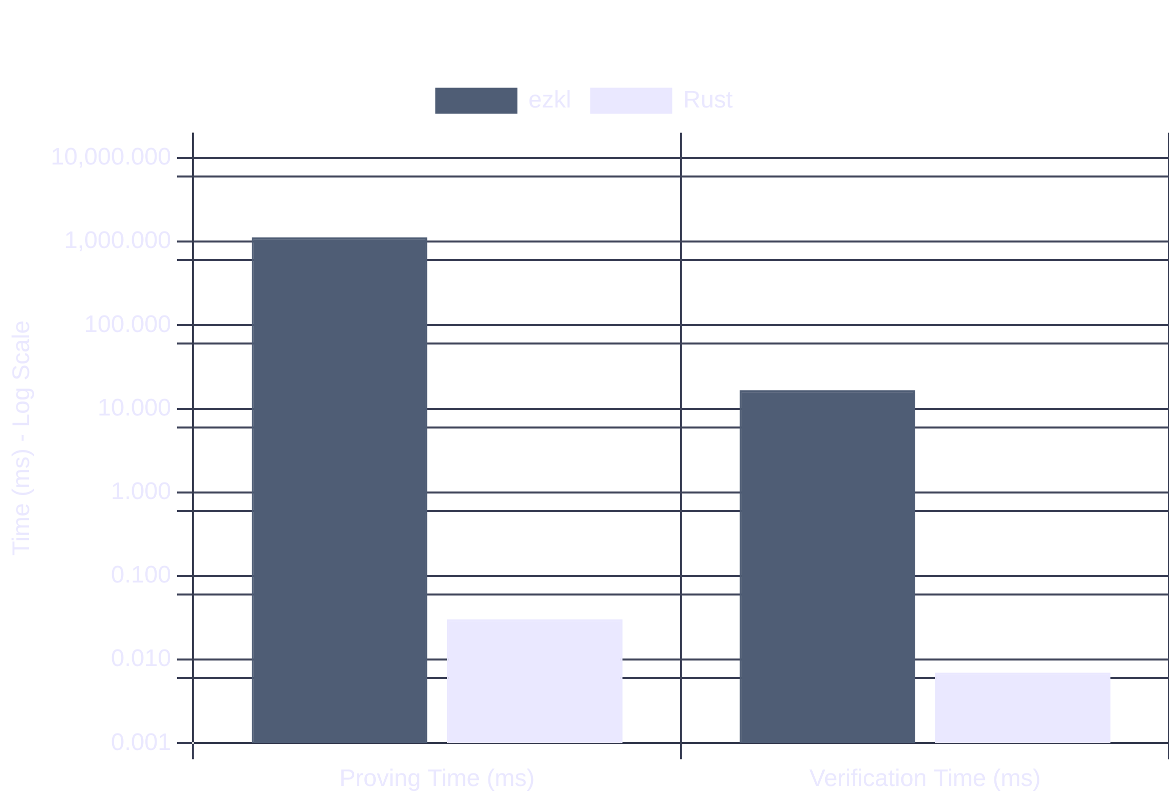
Usage: Benchmarking
Running Benchmarks:
ZKML Performance Comparison
python3 src/phaze/benchmarking.py
The benchmarking suite tests:
Early-exit model inference time
ZKML proving time (ezkl vs Rust)
ZKML verification time (ezkl vs Rust)
Sample Output:
m_early_inference_ms: 0.1021 ms
ezkl_proving_ms: 10054.5047 ms
ezkl_verification_ms: 76.9775 ms
rust_proving_ms: 0.0521 ms
rust_verification_ms: 0.0095 ms

Slide 5
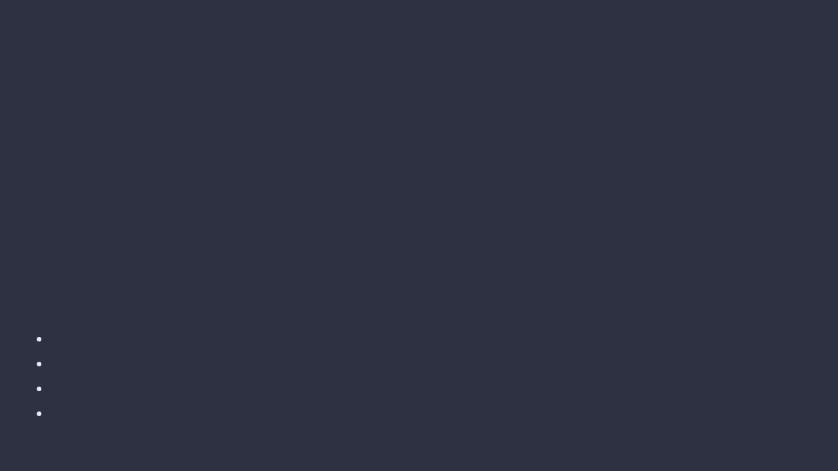
Usage: Testing
Running Unit Tests
The PHAZE framework includes comprehensive unit tests for all components:
cd phaze
pytest tests/
To run specific component tests:
pytest tests/test_early_exit_models.py
pytest tests/test_crypto_primitives.py
pytest tests/test_zkml_integration.py
Test Coverage
Early-exit models
: Tests model initialization, forward pass, and early-exit behavior
Cryptographic primitives
: Tests hashing functions and polynomial interpolation
ZKML integration
: Tests model export, proof generation, and verification
Rust bindings
: Tests Python-Rust interoperability and cryptographic functions

Slide 6
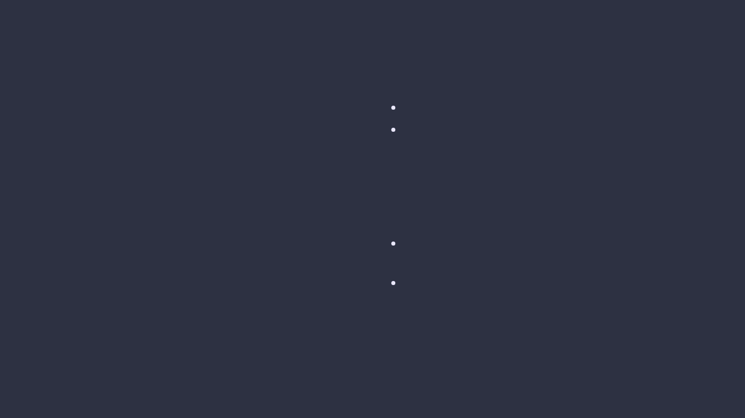
Documentation
Building Documentation:
Documentation Structure:
PHAZE uses Sphinx for auto-documentation:
API Reference
: Auto-generated from docstrings
cd docs
Module Documentation
:
make html
early_exit_models
crypto_primitives
The generated HTML documentation will be available in:
zkml_integration
docs/build/html/index.html
rust_zkml_backend
benchmarking
Usage Examples
: Code snippets demonstrating key functionality
README.md
: High-level overview and installation instructions

Slide 7

Modularity & Future Work
Current Modularity:
ZKML system switching between ezkl and Rust-based implementations
Separation of early-exit models from cryptographic primitives
Benchmarking suite that works with any component implementation
Python-Rust interoperability via PyO3 bindings
Future Work:
Integrate full-fledged Rust-based ZKML libraries (e.g., ddkang/zkml, arkworks-rs/snark)
Implement more sophisticated polynomial interpolation techniques
Develop realistic M_early models based on LHC physics requirements
Expand benchmarking with real-world LHC data processing scenarios
Optimize performance for high-throughput, low-latency environments
Research Opportunities:
Explore trade-offs between early-exit model accuracy and latency
Investigate zero-knowledge proofs for privacy-preserving ML inference
Benchmark different ZKML systems for particle physics applications

